Slide 1
Diabetic and Vascular ulcers
Dr. Santosh Dobhal
Dept. Of Cardiovascular & Respiratory Physiotherapy
MGM Institute Of Physiotherapy
Chh. Sambhajinagar

Slide 2
Neuropathy
SENSORY
AUTONOMIC
MOTOR

Slide 3
Sensory Neuropathy
Altered sense of Pain
Altered sense of Temperature
Altered sense of Proprioception
All these factors make the foot more susceptible to injuries without patient’s knowledge.

Slide 4
Motor Neuropathy
Muscle atrophy
Intrinsic Muscle Weakness
Callus
Abnormal Pressure Points
Various Foot Deformities
Increased risk of injury

Slide 5
Autonomic Neuropathy
Making foot more susceptible to infection.
Fissuring of Skin
Drying of skin
Reduced Sweating
Sympathetic Dysfunction

Slide 6
Mechanical Factors
Paresis of small muscles of the foot
Abnormal pressure points
Callus formation
Increased body weight
Abnormally prominent bones (Congenital, Previous injuries and surgeries)
Gycosylation of the connective tissue making it thick and inelastic

Slide 7
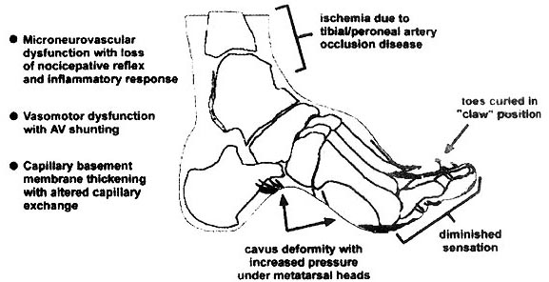
Structural Changes

Slide 8
CONSEQUENCES
If unchecked, untreated; Diabetic Foot can lead to:
Massive tissue necrosis
Gangrene
Charcot Foot
Septicemia
Amputation

Slide 9
Charcot Foot
Relatively painless, progressive and degenerative arthropathy of single or multiple joints caused by underlying neurological deficits
Cause: almost always Diabetes Mellitus
Any type of destructive or inflammatory process introduced to a neuropathic joint has the potential for creating a Charcot joint
Notes:
First described by Charcot in 1868
can occur in those with chronic alcoholism, syringomyelia, spina bifida, Hansen’s disease/leprosy, congenital insensitivity to pain, injuries to the peripheral nerves, meningomyelocele, tabes dorsalis.

Slide 10
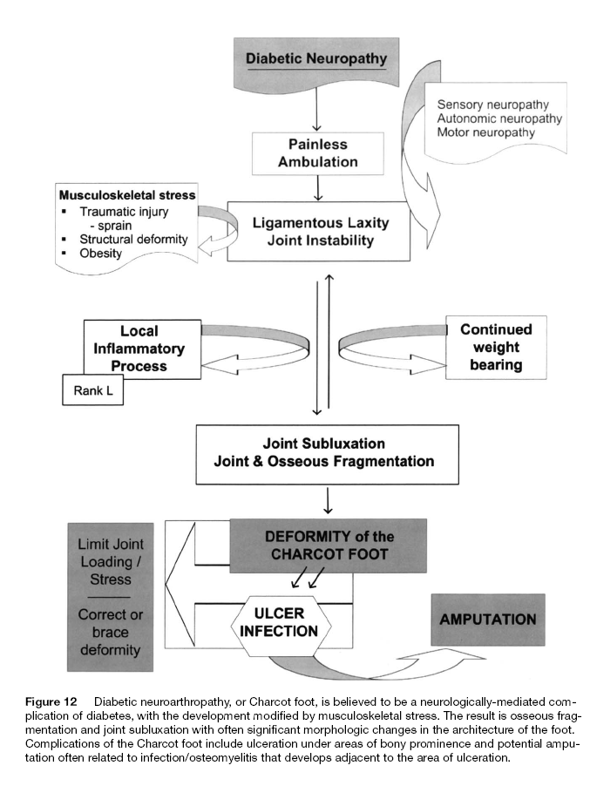

Slide 11
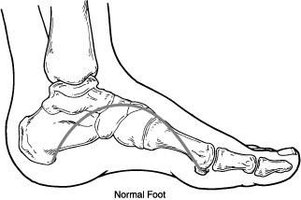
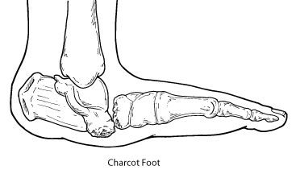

Slide 12
Clinical features of Charcot Foot
>10 years of diabetes
History of trauma
Early acute stages – erythema, increased skin temperature, deformity, instability, swelling
Neuropathy almost always present – but pain and discomfort often is present (but not as much as would be expected given extent of tissue damage)
Often hypermobile

Slide 13
Clinical features of Charcot Foot
Progression:
Complete destruction
Tubular bones of metatarsus and toes – atrophic changes (penciling and hour glass resorption )
Findings mimic those found in osteomyelitis
Can lead to ulcers if unchecked

Slide 14
THE AIM OF THE ASSESSMENT
To stratify the risk for development of ulcer
OR
To find out the cause of developed ulcer:
1) Ischaemia 2) Neuropathy 3) Structural

Slide 15
Chief Complaints
Asymptomatic
Numbness, tingling
Slipping of chappals
Pain
Pain on walking
Rest pain
Nocturnal Pain
Deformities of Foot/ Callus
Reduced joint mobility
NEUROPATHY
ISCHAEMIA
STRUCTURAL

Slide 16
Motor System
1) Deformity
2) Abnormal Pressure Areas: Foot Scan
3)Tightness of muscles
4) Manual muscle Testing
5) Reflexes
6) Muscle Girth
7) Gait: Gait Analyzer

Slide 17
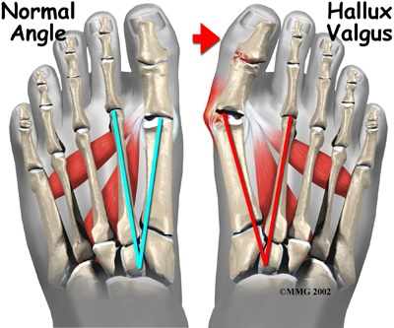
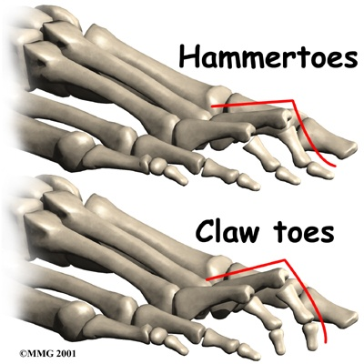
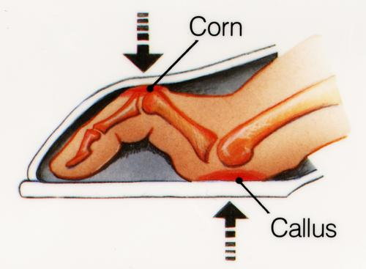
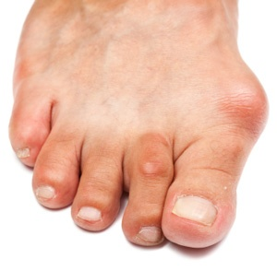
Deformity

Slide 18
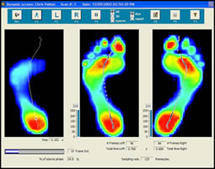
Foot Pressure Scan

Slide 19
Sensory System
Superficial Sensations:
1) Light Touch
2) Pain
3) Temperature
4) Pressure: Monofilament Testing- Insensitivity to a 10 gram monofilament is considered as risk for development of foot ulcer.
Notes:
Light touch- with help of a cotton wisp. Pain- pin prick. Temperature- with testubes. Pressure can also be checked with a neurotip of 40g

Slide 20
Pressure monofilament testing

Slide 21
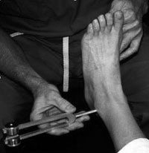
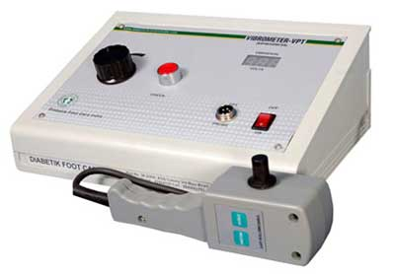
Deep Sensations:
Vibration: It can be measured using a Neurothesiometer or a Tuning Fork
Proprioception: Should be checked at the small joints of the feet.

Slide 22
Combined Cortical Sensations:
Two point discrimination
Kinesthetic sensation
Electro-diagnostic techniques such as NCV may also be used to diagnose neuropathy.

Slide 23
Vascular System
Colour of Feet, Rubor/ Pallor
Temperature of foot: Infra Red Thermal Sensor
Check for atrophic changes at nails, feet
Peripheral Pulse
Ankle Brachial Index
Capillary Refill Time
Check for Claudication Distance if history of Intermittent Claudication

Slide 24
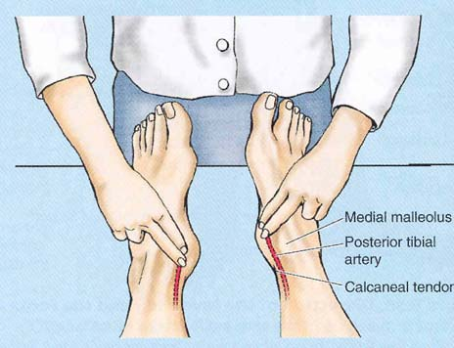
Peripheral pulses
DORSALIS PEDIS
POSTERIOR TIBIAL

Slide 25
Ankle Brachial Index
Range of ABI | Severity | Presentation
0.9-1.2 | Normal | Risk of vascular foot ulcer is less
0.6-0.9 | Definite vascular disease | Risk of vascular foot is moderate and depends on other risk factors
Less than 0.6 | Severe vascular disease | Risk of vascular foot ulcer is very high

Slide 26
Feet and Footwear
The general hygiene of the feet should be assessed to stratify and minimize risk of infection.
Footwear is also an area where detailed assessment is necessary. Important points to note:
Barefoot
Small and Tight Shoe
Shoe material unsuitable to climate
Hard, unyielding soles
Notes:
"Inspect the foot and then inspect the shoes as part of your evaluation," – Dr. Bakker at who conf 2005

Slide 27
Look for evidence
ISCHAEMIA: Cold Feet, Ankle Pulse diminished or absent, Atrophic skin, nails, Reduced Ankle Brachial Index.
NEUROPATHY: Loss of superficial and deep sensations, Absence of reflexes, normal temperature
STRUCTURAL CHANGES IS FOOT: Hammer Toes, Claw toes, Calluses, Abnormal Bony prominences
INFECTION: Damaged skin, open wound, pus, bleeding.

Slide 28
ULCER EXAMINATION
WHEN PATIENT PRESENTS DIRECTLY WITH AN ULCER
ULCERATED FOOT

Slide 29
Chief Complaints and History
Presence of an open wound/ ulcer.
Pain at Ulcer Site.
Inability or difficulty in ambulation.
All relevant medical history must be taken.
Also the history may give a clue as to involvement of ischaemic, neuropathic or structural components.

Slide 30
Present History
Onset
Duration
Association with Pain
Discharge

Slide 31
Inspection
Number
Position/ Site
Edge
Floor
Structures seen at the floor
Surrounding area

Slide 32
Palpation
Tenderness
Edge and margin
Dimensions
Base
Relationship with surrounding structures

Slide 33
Wagner Classification
0- Intact skin (may have bony deformities).
1- Localized superficial ulcer.
2- Deep ulcer to tendon, bone, ligament or joint.
3- Deep abscess or osteomyelitis.
4- Gangrene of toes or forefoot.
5- Gangrene of whole foot.

Slide 34
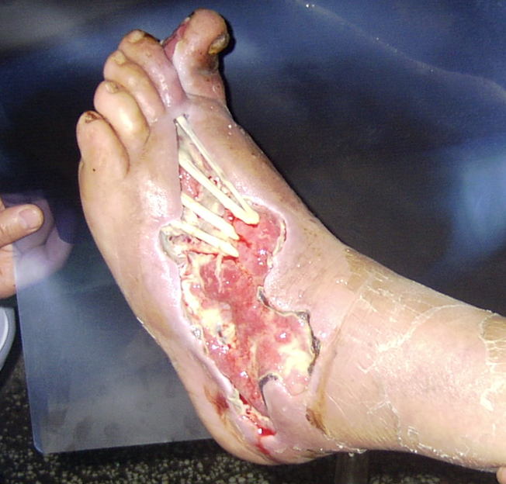
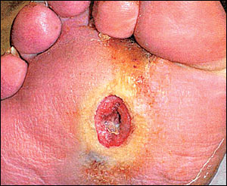
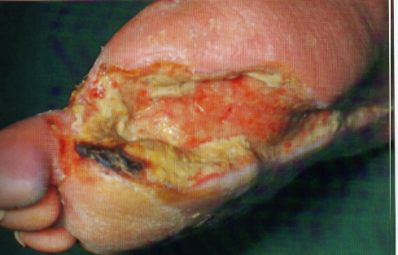
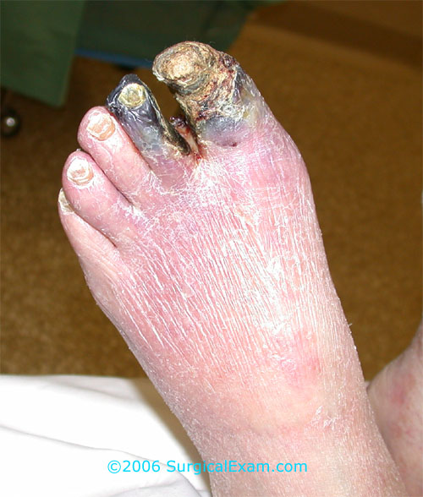
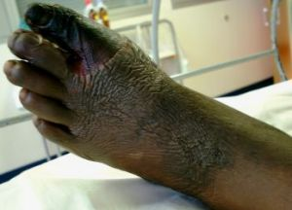

Slide 35
Vascular ulcers

Slide 36
An ulcer can be defined as a break in the epithelial continuity.
• Classified – Non- specific – Specific – Malignant
• A leg ulcer is discontinuity of the squamous epithelium of the skin usually around the ankle or on the foot

Slide 37
Classification of Chronic Leg Ulcers
VASCULAR ARTERIAL
• Atherosclerosis • Burger’s disease • Vasuclitis • Raynaud’s disease
VENOUS
• Chronic venous insufficiency • Varicose vein •
LYMPHATIC
• Chronic lymphedema

Slide 38
Leg ulcer aetiology Grey J.E et al. ABC Wound Healing BMJ 2006; 332: 347-50
• Venous insufficiency 80 - 85% (60 – 70 %)
• Arterial disease ( chronic lower limb ischemia) 20%
• Mixed arterial and venous disease
• Neuropathic Diabetic ulcer
• Rheumatoid arthritis - 7%
• Systemic vasculitis
• Lymphoedema
• Trauma
• Malignant ulcer (BCC, SCC, Malignant melanoma)
• Infective

Slide 39
CHRONIC VENOUS ULCER
• Chronic Venous Insufficiency (CVI) who have developed irreversible skin damage as the result of sustained ambulatory venous hypertension
• Chronic venous ulceration(CVU) defined as a break in the skin , present for more than 6 months , b/w the malleoli and tibial tuberosity that is presumed to be wholly or partially due to venous disease

Slide 40
PATHOPHYSIOLOGY CVU
• CVI, culminating in CVU is the end result of sustained ambulatory venous hypertension acting upon a dermal microcirculation designed to operate in the presences of low venous pressure
• Ambulatory venous pressure (AVP) –
Normal - < 25Hg –
>30 – inc incidence of CVU
• 31-40 mmHg- 15%
• >90mmHg- 100%

Slide 41
Macrovascular
• Muscle pump dysfunction – Ageing\ General debility/ MSK n neurological LL pathologies
( fixed ankle, flat foot)
• Valvular reflux (90% in CVI)
– Primary valvular incompetence ( elastin/collagen)
– Secondary valvular incompetence (post phlebitic)
• Venous obstruction
• Valvular hypoplasia/ agenesis

Slide 42
Microvascular
• Venous stasis n hypoxia
• Arteriovnous fistula ( stealing blood from skin)
• Peri-capillary fibrin cuff( Browse n Burnand)
• Leucocyte Migration (coleridge –smith)
• Capillary Proliferation

Slide 44
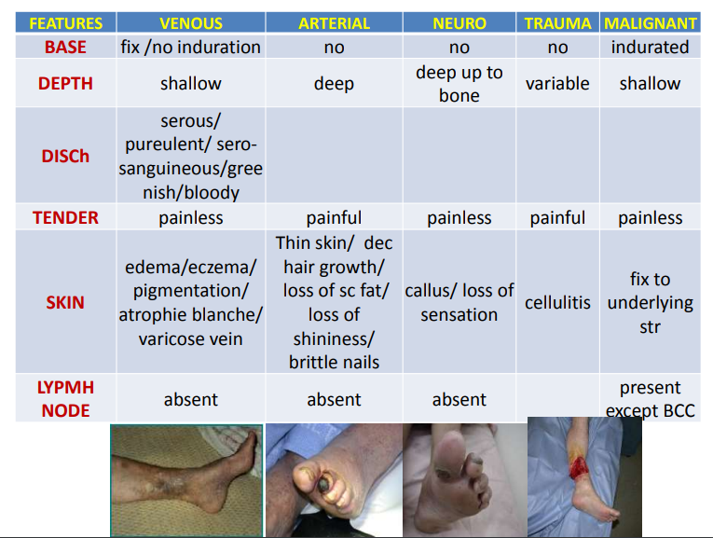

Slide 45
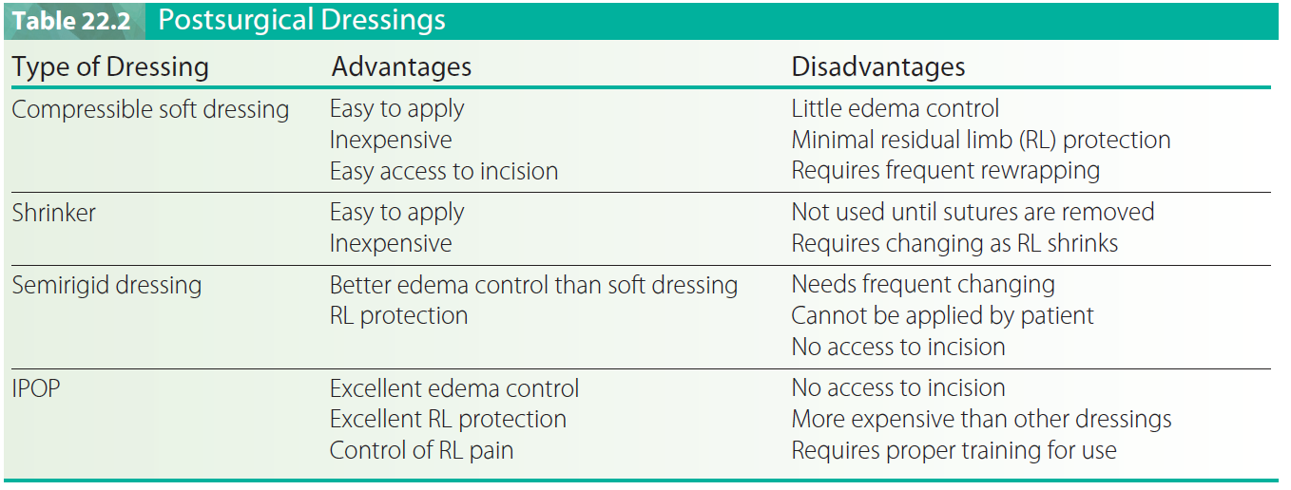
Amputation Care
POSTSURGICAL DRESSINGS

Slide 46
PHASES OF CARE
Postsurgical -The postsurgical phase is the time between surgery and discharge from the hospital
Preprosthetic phase- Runs from hospital discharge to prosthetic fitting or a decision that the patient is not a candidate for prosthetic fitting.

Slide 47
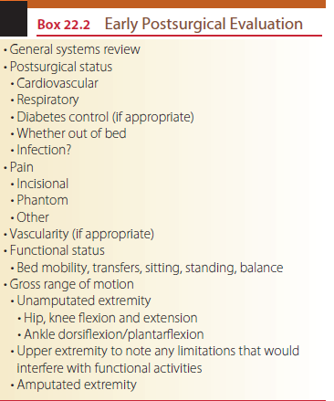

Slide 48
POSTSURGICAL PHASE
While the primary goal of this phase of care is to get the patient discharged, it is not adequate to give the patient a walker, teach the patient to transfer, and send him or her home.
GOALS
Healing residual limb
• Protect remaining limb (if dysvascular)
• Independent in transfers and mobility
• Demonstrate proper positioning
• Begin psychological adjustment
• Understand the process of prosthetic rehabilitation

Slide 49
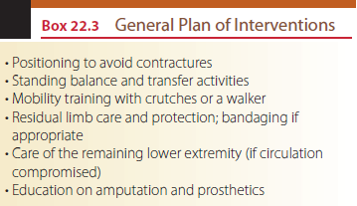

Slide 50
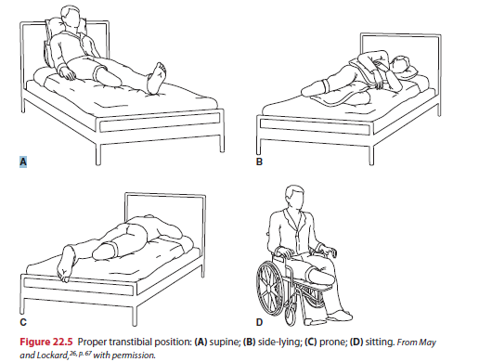
Positioning

Slide 51
Balance and Transfers
Sitting balance is usually not a problem with a unilateral amputation but must be a part of the intervention program for individuals with bilateral amputations.
Standing balance exercises on the remaining extremity can be quite beneficial in helping the individual regain a sense of his or her body in space.

Slide 52
Mobility
Many physical therapists fit patients with a walker. Although this is appropriate for some individuals, trying to teach the patient safe and independent mobility with crutches is much more beneficial.

Slide 53
Residual Limb Care
The physical therapist will need to teach the patient and family how to properly wrap the limb, and, if the patient has been fitted with an IPOP(Immediate Post-Operative Prosthesis) or RRD (Removable rigid dressing), the physical therapist needs to be alert to excessive bleeding or draining through the cast
A primary focus at this point is to teach the patient how to protect the residual limb while moving in bed, coming to sitting, and transferring.

Slide 54
Residual Limb Care
Patient should not put pressure on the limb or drag it on the bed. Slightly raising the residual limb and moving it to the side while rolling to the unamputated side is the best way to come to sitting.
The patient can be encouraged to move the limb gently within a pain-free range both at the knee (transtibial) and at the hip (both levels).

Slide 55
PREPROSTHETIC PHASE
The preprosthetic phase is the time between discharge from the acute care hospital and fitting with a definitive prosthesis, or the decision not to fit the patient with an artificial limb

Slide 56
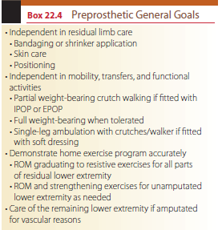
PREPROSTHETIC PHASE

Slide 57
Residual limb measurements are generally taken and reported in centi-meters for uniformity with others involved in the care of individuals who have had an amputation.
Circumferential measurements of the residual limb are taken
Length

Slide 58
Range of Motion
Gross range of motion (ROM) estimations are generally adequate for examination of the uninvolved extremity but specific goniometric measurements are necessary for the amputated side, bilateral hip extension, and ankle dorsiflexion of the unamputated side.

Slide 59
Muscle Strength
Gross manual muscle testing (MMT) of the upper extremities (UEs) and uninvolved LE is performed as part of the initial examination. MMT of the involved LE must usually wait until most healing has occurred.

Slide 60
Phantom Limb
The majority of individuals will encounter phantom limb sensations following amputation. In its simplest form, the phantom is the sensation of the limb that is no longer there.
The phantom, which may occur initially immediately after surgery or as long as a year after amputation, is often described as a tingling, burning, itching, or pressure sensation, or sometimes a numbness

Slide 61
Residual Limb Wrapping
Patients tend to wrap their own residual limb in a circular manner, often creating a tourniquet, which may compromise healing and foster the development of a bulbous end. Although the transtibial residual limb can be effectively wrapped in a sitting position, it is difficult to properly wrap and anchor the transfemoral limb while sitting.

Slide 62
Residual Limb Wrapping
Older patients often cannot balance themselves in the standing position while wrapping.
An effective bandage is smooth and wrinkle free, emphasizes angular turns, provides pressure distally, and encourages proximal joint extension.
The ends of bandages are fastened with tape or safety pins, rather than clips, which can cut the skin and do not anchor well.
A system of wrapping that uses mostly angular or figure-of-eight turns was developed specifically to meet the needs of the older patient

Slide 63
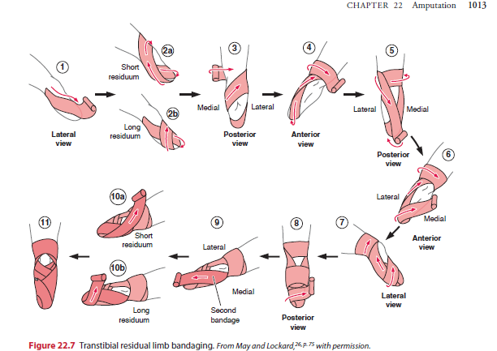

Slide 64
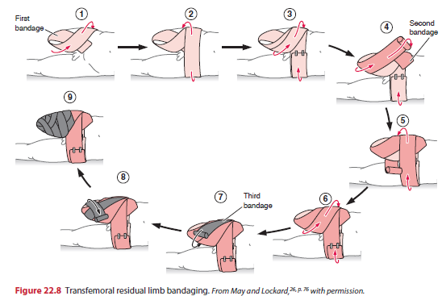

Slide 65
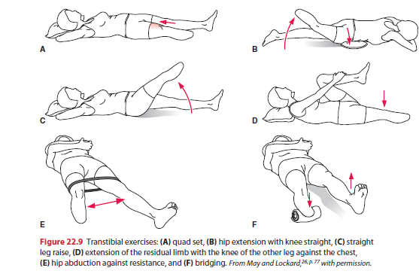

Slide 66
